Slide 1
Complex Variable, Laplace & Z- Transformation
Learning Outcomes
Exercises Using First Shifting Property
Examples Using First Shifting Property
First Translation Property & Example
Exercise Using Direct Formula
Examples Using Direct Formula
Important Formulae
This Lecture Covers
Inverse Laplace Transformation
Lecture 04

Slide 2
1. Formula of Inverse Laplace Transformation.
2. Examples & Exercise of Inverse Laplace Transformation Using Direct Formula.
3. First Shifting Property of Inverse Laplace Transformation.
4. Examples & Exercises of Inverse Laplace Transformation Using First Shifting Property.
Learning Outcomes
Exercises Using First Shifting Property
Examples Using First Shifting Property
First Translation Property & Example
Exercise Using Direct Formula
Examples Using Direct Formula
Important Formulae
This Lecture Covers
Inverse Laplace Transformation

Slide 3

$ℒ^{−1}\left\{\frac{1}{s}\right\}=1,$
2. $ℒ^{−1}\left\{\frac{1}{s^{n+1 }}\right\}=\frac{t^{n}}{n!},$
3. $ℒ^{−1}\left\{\frac{1}{s−a}\right\}=e^{at},$
4. $ℒ^{−1}\left\{\frac{s}{s^{2}+a^{2}}\right\}=\cos{at,}$
5. $ℒ^{−1}\left\{\frac{a}{s^{2}+a^{2}}\right\}=\sin{at,}$
6. $ℒ^{−1}\left\{\frac{s}{s^{2}−a^{2}}\right\}=\cosh{at,}$
7. $ℒ^{−1}\left\{\frac{a}{s^{2}−a^{2}}\right\}=\sinh{at.}$
Learning Outcomes
Exercises Using First Shifting Property
Examples Using First Shifting Property
First Translation Property & Example
Exercise Using Direct Formula
Examples Using Direct Formula
Important Formulae
This Lecture Covers
Inverse Laplace Transformation

Slide 4
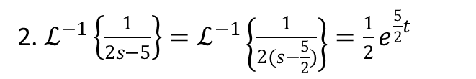
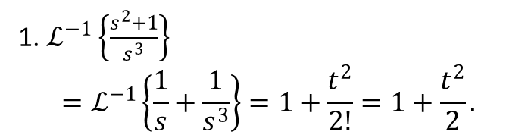

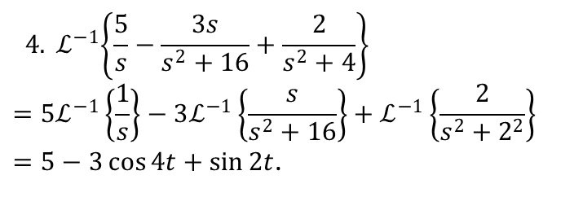
1. $ℒ^{−1}\left\{\frac{s^{2}+1}{s^{3}}\right\}$
$$=ℒ^{−1}\left\{\frac{1}{s}+\frac{1}{s^{3}}\right\}=1+\frac{t^{2}}{2!}=1+\frac{t^{2}}{2}.$$
2. $ℒ^{−1}\left\{\frac{1}{2s−5}\right\}=ℒ^{−1}\left\{\frac{1}{2(s−\frac{5}{2})}\right\}=\frac{1}{2}e^{\frac{5}{2}t}$
3. $ℒ^{−1}\left\{\frac{2s}{s^{2}−9}\right\}={2ℒ}^{−1}\left\{\frac{s}{s^{2}−3^{2}}\right\}=2cosh{3t}$
Learning Outcomes
Exercises Using First Shifting Property
Examples Using First Shifting Property
First Translation Property & Example
Exercise Using Direct Formula
Examples Using Direct Formula
Important Formulae
This Lecture Covers
Inverse Laplace Transformation
$${ 4. ℒ}^{−1}\left\{\frac{5}{s}−\frac{3s}{s^{2}+16}+\frac{2}{s^{2}+4}\right\}={5ℒ}^{−1}\left\{\frac{1}{s}\right\}−3ℒ^{−1}\left\{\frac{s}{s^{2}+16}\right\}+ℒ^{−1}\left\{\frac{2}{s^{2}+2^{2}}\right\}$$
$=5−3\cos{4t}+\sin{2t}$.

Slide 5

Find The Inverse Laplace Transformation of
the following functions:
$F\left(s\right)=\frac{1}{s−5} ,$
2. $F\left(s\right)=\frac{1}{s^{5}} ,$
3. $F\left(s\right)= \frac{s^{3}−5s^{2}+6}{s^{4}} ,$
4. $F\left(s\right)= \frac{2+4s}{s^{2}+25} ,$
5. $F\left(s\right)= \frac{3}{s^{2} + 4 },$
6. $F\left(s\right)=\frac{3}{s^{2 }− 4} .$
Learning Outcomes
Exercises Using First Shifting Property
Examples Using First Shifting Property
First Translation Property & Example
Exercise Using Direct Formula
Examples Using Direct Formula
Important Formulae
This Lecture Covers
Inverse Laplace Transformation

Slide 6



First translation property
If $ℒ^{−1}\left\{F(s)\right\}=f(t)$ then
$$𝓛^{−1}\left\{F(s−a)\right\}=e^{at}ℒ^{−1}\left\{F\left(s\right)\right\}.$$
Example: 01
$$ℒ^{−1}\left\{\frac{10}{{\left(s+3\right)}^{4}}\right\}$$
$$={10ℒ}^{−1}\left\{\frac{1}{{\left(s+3\right)}^{4}}\right\} \\ ={10e^{−3t}ℒ}^{−1}\left\{\frac{1}{s^{4}}\right\} \\ =10e^{−3t}\frac{t^{3}}{3!}=\frac{10}{6}e^{−3t}t^{3}\text{.}$$
Learning Outcomes
Exercises Using First Shifting Property
Examples Using First Shifting Property
First Translation Property & Example
Exercise Using Direct Formula
Examples Using Direct Formula
Important Formulae
This Lecture Covers
Inverse Laplace Transformation
Example: 02
$$ℒ^{−1}\left\{\frac{1}{{(s−2)}^{2}+1}\right\}$$
$$=e^{2t}ℒ^{−1}\left\{\frac{1}{s^{2}+1}\right\} \\ =e^{2t}\sin{t}\text{.}$$

Slide 7

Example 3.
$${\begin{aligned} \\ ℒ\end{aligned}}^{−1}\left\{\frac{2s+1}{s^{2}+4s+13}\right\}$$
$$=ℒ^{−1}\left\{\frac{2s+1}{s^{2}+2.s.2+4+9}\right\}$$
$$=ℒ^{−1}\left\{\frac{2\left(s+2\right)−3}{{(s+2)}^{2}+9}\right\}$$
$${=ℒ}^{−1}\left\{\frac{2\left(s+2\right)}{{(s+2)}^{2}+3^{2}}−\frac{3}{{(s+2)}^{2}+3^{2}}\right\}$$
$$=2e^{−2t}\cos{3t− e^{−2t}\sin{3t.}}$$
Learning Outcomes
Exercises Using First Shifting Property
Examples Using First Shifting Property
First Translation Property & Example
Exercise Using Direct Formula
Examples Using Direct Formula
Important Formulae
This Lecture Covers
Inverse Laplace Transformation

Slide 8

Find Inverse Laplace of the following functions:
$F\left(s\right)= \frac{1}{{\left(s−3\right)}^{4}} ,$
2. $F\left(s\right)=\frac{3}{{\left(s+2\right)}^{2} + 9} ,$
3. $F\left(s\right)= \frac{s−2}{{\left(s−2\right)}^{2}−16}$,
4. $F\left(s\right)= \frac{s}{s^{2}+4s−9},$
5. $F\left(s\right)= \frac{5s−7}{s^{2}−6s+25} ,$
6. $F\left(s\right)=\frac{s}{s^{2}−6s+10} .$
Learning Outcomes
Exercises Using First Shifting Property
Examples Using First Shifting Property
First Translation Property & Example
Exercise Using Direct Formula
Examples Using Direct Formula
Important Formulae
This Lecture Covers
Inverse Laplace Transformation

Slide 9
After completing this chapter you can easily evaluate the inverse Laplace transformation of function using direct formula & also using property.
Learning Outcomes
Exercises Using First Shifting Property
Examples Using First Shifting Property
First Translation Property & Example
Exercise Using Direct Formula
Examples Using Direct Formula
Important Formulae
This Lecture Covers
Inverse Laplace Transformation

Slide 10
THE END
Learning Outcomes
Exercises Using First Shifting Property
Examples Using First Shifting Property
First Translation Property & Example
Exercise Using Direct Formula
Examples Using Direct Formula
Important Formulae
This Lecture Covers
Inverse Laplace Transformation

Slide 11

















Sample MCQ
$$1. ℒ^{−1}\left\{\frac{s^{2}+1}{s^{3}}\right\}=?$$
(a) $1+\frac{t}{2}$
(b) $1+\frac{t^{2}}{2}$
(c) $1−\frac{t^{2}}{2}$
(d) $\frac{t^{2}}{2}$
2.${ ℒ}^{−1}\left\{\frac{4}{s−2}−\frac{s}{s^{2}−16}+\frac{4}{s^{2}−4}\right\}=?$
(a) $e^{2t}−\cosh{4t+2\sinh{2t}}$
(b) $4e^{2t}+\cosh{4t+2\sinh{2t}}$
(c) $4e^{2t}−\cosh{4t+2\sinh{2t}}$
(d) $4e^{2t}−\cosh{4t}$
3. ${ ℒ}^{−1}\left\{\frac{s}{s^{2}+4s+13}\right\}=?$
(a) $e^{−2t}\cos{3t}−\frac{2}{3}e^{−2t}\sin{3t}$
(b) $e^{−2t}\cos{3t}−\frac{2}{3}e^{−2t}\sin{3t}$
(c) $e^{−2t}\cos{3t}−\frac{2}{3}e^{−2t}\sin{3t}$
(d) $e^{−2t}\cos{3t}−\frac{2}{3}e^{−2t}\sin{3t}$
4. $ℒ^{−1}\left\{\frac{s−2}{{\left(s−2\right)}^{2}−16}\right\}$=?
(a) $\frac{e^{2t}}{2} + \frac{e^{6t}}{2}$
(b) $\frac{e^{−2t}}{2} + \frac{e^{−6t}}{2}$
(c) $\frac{e^{−2t}}{2} + \frac{e^{4t}}{2}$
(d) $\frac{e^{−2t}}{2} + \frac{e^{6t}}{2}$

